Slide 1

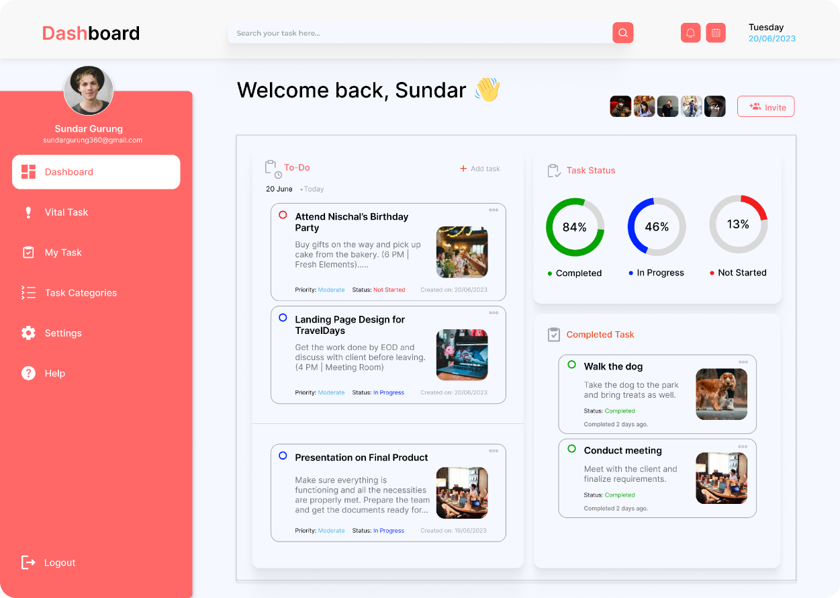

Slide 2



Sign Up
Enter First Name
Enter Last Name
Enter Username
Enter Email
Enter Password
Confirm Password
I agree to all terms
Already have an account? Sign In

Slide 3



























Dashboard
Search your task here...
Tuesday
20/06/2023
Welcome back, Sundar
+4
Sundar Gurung
sundargurung360@gmail.com
Send an invite to a new member
Go Back
Dashboard
To-Do
Task Status
Email
20 June
Today
neerajgurung99@gmail.com
Send Invite
Attend Nischal’s Birthday
Party
84%
46%
13%
Members
Buy gifts on the way and pick up cake from the bakery. (6 PM | Fresh Elements).....
Upashna Gurung
Can edit
uppaeygrg332@gmail.com
Completed
In Progress
Not Started
Jeremy Lee
Priority: Moderate
Status: Not Started
Created on: 20/06/2023
Can edit
jerrylee1996@gmail.com
Landing Page Design for TravelDays
Thomas Park
Owner
parktho123@gmail.com
Completed Task
Get the work done by EOD and discuss with client before leaving. (4 PM | Meeting Room)
Rachel Takahasi
Can edit
Walk the dog
takahasirae32@gmail.com
Walk the dog
Take the dog to the park and bring treats as well.
Priority: Moderate
Status: In Progress
Created on: 20/06/2023
Take the dog to the park and bring treats as well.
Project Link
Status: Completed
Completed 2 days ago.
https://sharelinkhereandthere.com/34565yy29
Copy Link
Completed 2 days ago.
Conduct Client Meeting
Presentation on Final Product
Conduct meeting
Conduct meeting and finalize the requirement specification.
Meet with the client and finalize requirements.
Make sure everything is functioning and all the necessities are properly met. Prepare the team and get the documents ready for...
Status: Completed
Completed 2 days ago.
Status: Completed
Completed 2 days ago.
Priority: Moderate
Status: In Progress
Created on: 19/06/2023

Slide 4
Dashboard
Search your task here...
Tuesday
20/06/2023
Welcome back, Sundar
+4
Sundar Gurung
sundargurung360@gmail.com
Dashboard
To-Do
Task Status
20 June
Today
Attend Nischal’s Birthday
Party
84%
46%
13%
Buy gifts on the way and pick up cake from the bakery. (6 PM | Fresh Elements).....
Completed
In Progress
Not Started
Priority: Moderate
Status: Not Started
Created on: 20/06/2023
Landing Page Design for TravelDays
Completed Task
Get the work done by EOD and discuss with client before leaving. (4 PM | Meeting Room)
Walk the dog
Walk the dog
Take the dog to the park and bring treats as well.
Priority: Moderate
Status: In Progress
Created on: 20/06/2023
Take the dog to the park and bring treats as well.
Status: Completed
Completed 2 days ago.
Completed 2 days ago.
Conduct Client Meeting
Presentation on Final Product
Conduct meeting
Conduct meeting and finalize the requirement specification.
Meet with the client and finalize requirements.
Make sure everything is functioning and all the necessities are properly met. Prepare the team and get the documents ready for...
Status: Completed
Completed 2 days ago.
Status: Completed
Completed 2 days ago.
Priority: Moderate
Status: In Progress
Created on: 19/06/2023

Slide 5






To-Do
Search your task here...
Tuesday
20/06/2023
My Tasks
Sundar Gurung
Submit Documents
Submit Documents
sundargurung360@gmail.com
Make sure to submit all the necessary docum.....
Priority: Extreme
Status: Not Started
Priority: Extreme
Created on: 20/06/2023
Status: Not Started
Created on: 20/06/2023
Task Title: Document Submission.
Objective: To submit required documents for something important
Task Description: Review the list of documents required for submission and ensure all necessary documents are ready. Organize the documents accordingly and scan them if physical copies need to be submitted digitally. Rename the scanned files appropriately for easy identification and verify the accepted file formats. Upload the documents securely to the designated platform, double-check for accuracy, and obtain confirmation of successful submission. Follow up if necessary to ensure proper processing.
Additional Notes:
Ensure that the documents are authentic and up-to-date.
Maintain confidentiality and security of sensitive information during the submission process.
If there are specific guidelines or deadlines for submission, adhere to them diligently.
Deadline for Submission: End of Day
Complete assignments
My Task
The assignments must be completed to pass final year....
Priority: Moderate
Status: In Progress
Created on: 20/06/2023

Slide 6


To-Do
Search your task here...
Tuesday
20/06/2023
Vital Tasks
Sundar Gurung
Walk the dog
Walk the dog
sundargurung360@gmail.com
Take the dog to the park and bring treats as well.....
Priority: Extreme
Status: Not Started
Priority: Extreme
Created on: 20/06/2023
Status: Not Started
Created on: 20/06/2023
Vital Task
Take grandma to hospital
Take the dog to the park and bring treats as well.
Go back home and take grandma to the hosp....
Take Luffy and Jiro for a leisurely stroll around the neighborhood. Enjoy the fresh air and give them the exercise and mental stimulation they need for a happy and healthy day. Don't forget to bring along squeaky and fluffy for some extra fun along the way!
Priority: Moderate
Status: In Progress
Created on: 20/06/2023
Listen to a podcast or audiobook
Practice mindfulness or meditation
Take photos of interesting sights along the way
Practice obedience training with your dog
Chat with neighbors or other dog walkers
Listen to music or an upbeat playlist

Slide 7

To-Do
Search your task here...
Tuesday
20/06/2023
Change Password
Go Back
Sundar Gurung
sundargurung360@gmail.com
Sundar Gurung
sundargurung360@gmail.com
Current Password
New Password
Confirm Password
Update Password
Cancel

Slide 8
To-Do
Search your task here...
Tuesday
20/06/2023
Account Information
Go Back
Sundar Gurung
sundargurung360@gmail.com
Sundar Gurung
sundargurung360@gmail.com
First Name
Last Name
Email Address
Contact Number
Position
Update Info
Change Password

Slide 9




Dashboard
Search your task here...
Tuesday
20/06/2023
Welcome back, Sundar
+4
Sundar Gurung
Add New Task
Go Back
sundargurung360@gmail.com
Title
To-Do
Task Status
20 June
Today
Date
Attend Nischal’s Birthday
Party
84%
46%
13%
Buy gifts on the way and pick up cake from the bakery. (6 PM | Fresh Elements)
Priority
Completed
In Progress
Not Started
Extreme
Moderate
Low
Task Description
Priority: Moderate
Status: Not Started
Created on: 20/06/2023
Upload Image
Start writing here.....
Landing Page Design for TravelDays
Completed Task
Get the work done by EOD and discuss with client before leaving. (4 PM | Meeting Room)
Walk the dog
Walk the dog
Drag&Drop files here
Take the dog to the park and bring treats as well.
Take the dog to the park and bring treats as well.
Priority: Moderate
Status: In Progress
Created on: 20/06/2023
or
Browse
Status: Completed
Completed 2 days ago.
Completed 2 days ago.
Conduct Client Meeting
Presentation on Final Product
Conduct meeting
Done
Conduct meeting and finalize the requirement specification.
Meet with the client and finalize requirements.
Make sure everything is functioning and all the necessities are properly met. Prepare the team and get the documents ready for...
Status: Completed
Completed 2 days ago.
Status: Completed
Completed 2 days ago.
Priority: Moderate
Status: In Progress
Created on: 19/06/2023

Slide 10


To-Do
Search your task here...
Tuesday
20/06/2023
Attend Nischal’s Birthday Party
Go Back
Sundar Gurung
Priority: Moderate
sundargurung360@gmail.com
Status: Not Started
Created on: 20/06/2023
Buy gifts on the way and pick up cake from the bakery. (6 PM | Fresh Elements)
A cake, with candles to blow out. (Layer cake, cupcake, flat sheet cake)
The birthday song.
A place to collect gifts.
Optional:
Paper cone-shaped party hats, paper whistles that unroll.
Games, activities (carry an object with your knees, then drop it into a milk bottle.)
Lunch: sandwich halves, or pizza slices, juice, pretzels, potato chips…THEN cake & candles and the song.

Slide 11

Dashboard
Search your task here...
Tuesday
20/06/2023
Welcome back, Sundar
+4
Sundar Gurung
Edit Task
Go Back
sundargurung360@gmail.com
Title
To-Do
Task Status
20 June
Today
Date
Attend Nischal’s Birthday
Party
84%
46%
13%
Buy gifts on the way and pick up cake from the bakery. (6 PM | Fresh Elements)
Priority
Completed
In Progress
Not Started
Extreme
Moderate
Low
Task Description
Priority: Moderate
Status: Not Started
Created on: 20/06/2023
Upload Image
Start writing here.....
Landing Page Design for TravelDays
Completed Task
Get the work done by EOD and discuss with client before leaving. (4 PM | Meeting Room)
Walk the dog
Walk the dog
Drag&Drop files here
Take the dog to the park and bring treats as well.
Take the dog to the park and bring treats as well.
Priority: Moderate
Status: In Progress
Created on: 20/06/2023
or
Browse
Status: Completed
Completed 2 days ago.
Completed 2 days ago.
Conduct Client Meeting
Presentation on Final Product
Conduct meeting
Done
Conduct meeting and finalize the requirement specification.
Meet with the client and finalize requirements.
Make sure everything is functioning and all the necessities are properly met. Prepare the team and get the documents ready for...
Status: Completed
Completed 2 days ago.
Status: Completed
Completed 2 days ago.
Priority: Moderate
Status: In Progress
Created on: 19/06/2023

Slide 12
To-Do
Search your task here...
Tuesday
20/06/2023
Account Information
Go Back
Sundar Gurung
sundargurung360@gmail.com
Sundar Gurung
sundargurung360@gmail.com
First Name
Last Name
Email Address
Contact Number
Position
Save Changes
Cancel

Slide 13


To-Do
Search your task here...
Tuesday
20/06/2023
Task Categories
Go Back
Sundar Gurung
sundargurung360@gmail.com
Add Category
Task Status
SN
Task Status
Action
1
Completed
Edit
Delete
2
In Progress
Edit
Delete
Task Categories
3
Not Started
Edit
Delete
Task Priority
SN
Task Priority
Action
1
Extreme
Edit
Delete
2
Moderate
Edit
Delete
3
Low
Edit
Delete

Slide 14
To-Do
Search your task here...
Tuesday
20/06/2023
Create Categories
Go Back
Sundar Gurung
Category Name
sundargurung360@gmail.com
Create
Cancel
Task Categories

Slide 15

To-Do
Search your task here...
Tuesday
20/06/2023
Task Categories
Go Back
Sundar Gurung
Add Task Priority
Go Back
sundargurung360@gmail.com
Add Category
Task Priority Title
SN
Task Status
Action
Create
Create
Cancel
1
Completed
Edit
Delete
My Task
2
In Progress
Edit
Delete
3
Not Started
Edit
Delete
SN
Task Priority
Action
1
Extreme
Edit
Delete
2
Moderate
Edit
Delete
3
Low
Edit
Delete

Slide 16
To-Do
Search your task here...
Tuesday
20/06/2023
Task Categories
Go Back
Sundar Gurung
Edit Task Priority
Go Back
sundargurung360@gmail.com
Add Category
Task Priority Title
SN
Task Status
Action
Update
Cancel
1
Completed
Edit
Delete
My Task
2
In Progress
Edit
Delete
3
Not Started
Edit
Delete
SN
Task Priority
Action
1
Extreme
Edit
Delete
2
Moderate
Edit
Delete
3
Low
Edit
Delete

Slide 17
To-Do
Search your task here...
Tuesday
20/06/2023
Task Categories
Go Back
Sundar Gurung
Edit Task Status
Go Back
sundargurung360@gmail.com
Add Category
Task Status Name
SN
Task Status
Action
Update
Cancel
1
Completed
Edit
Delete
My Task
2
In Progress
Edit
Delete
3
Not Started
Edit
Delete
SN
Task Priority
Action
1
Extreme
Edit
Delete
2
Moderate
Edit
Delete
3
Low
Edit
Delete

